Slide 1

BIG DATA Introduction

Slide 2

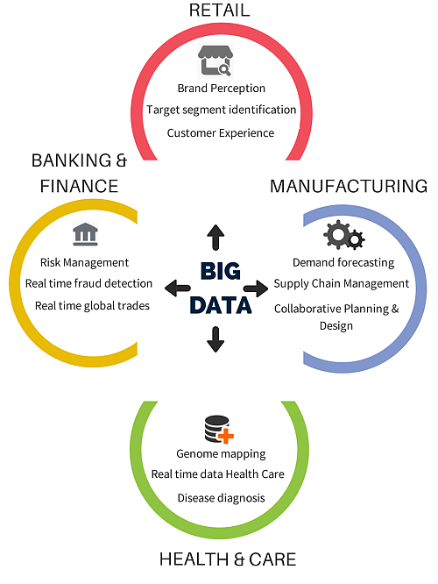
Industries using Big data

Slide 3
Challenges of traditional decision-making
Takes long time to arrive at a decision.
Planning, execution and reporting is not linked
Provides only birds eye view
Unable to make fully informed decisions

Slide 4
Big Data Analytics as a solution
Decision making based on analytics
Capable of handling all type of data
Faster decision making
Detailed view
Comprehensive solution gathering all the aspects

Slide 5
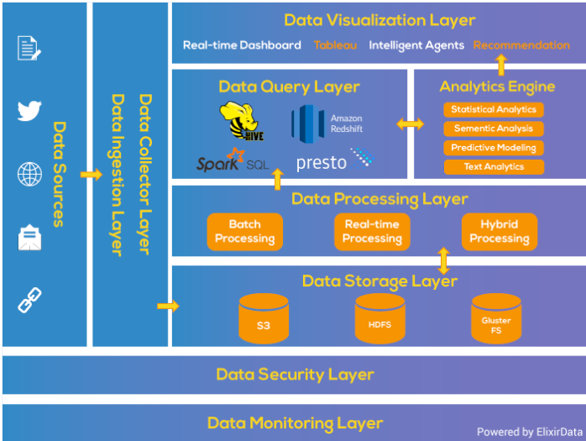


Big data Analytical Pipeline
https://www.xenonstack.com/blog/big-data-architecture/

Slide 6
What is Big data
Big Data is a collection of data that is huge in volume, yet growing exponentially with time. It is a data with so large size and complexity that none of traditional data management tools can store it or process it efficiently. Big data is also a data but with huge size.

Slide 7
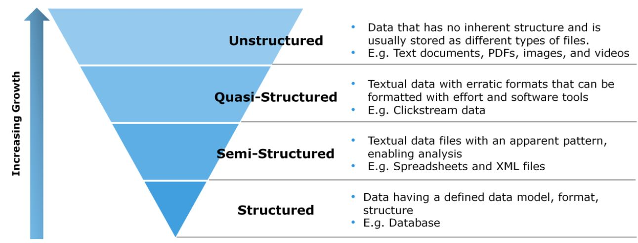
Types of Data

Slide 8
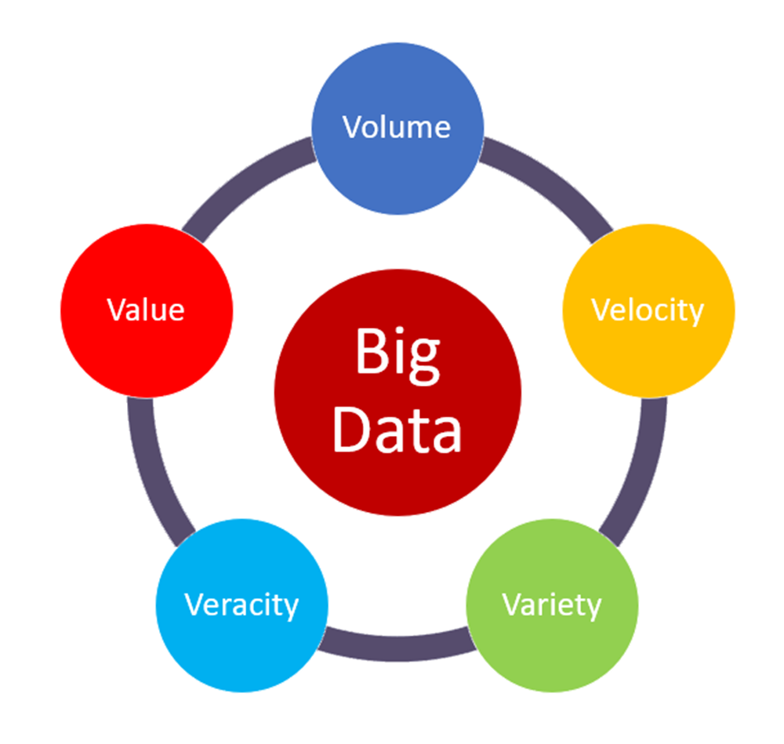
5 V’s of Big Data

Slide 9
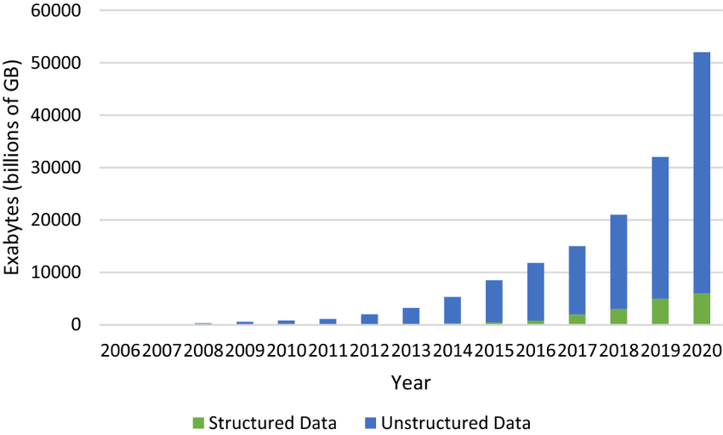
Growth of structured data vs unstructured data

Slide 10
